Slide 1



SCHOOL MANAGEMENT SYSTEM Nti dey c and embedded c Module final project
Presented by:
Hesham Mahmoud Ramzy Elsedfy
Under Supervision:
Eng Aya Abdelwahab

Slide 2
About the Project
This project is a school management system that asks the user to enter how he want to sort the students data (sort by name or sort by ID)
Then it asks the user what he want to do
(insert student – delete student –print Student list-edit specific student data – update CS scores for all the students )

Slide 3
Program Functions
Main_Menu();
This function displays the main menu that asks the user to choose how he want to sort the students data then asks him which operation he want to do (insert student – delete student –print Student list-edit specific student data – update CS scores for all the students )
Create_School()
This function initialize the List in which student data will be added

Slide 4
Program Functions
New_Student_Name()
This function takes the student data from the user
(Name, ID , Phone Number , Birth Date ,CS score)
And insert it to the Linked List sorted by Name
New_Student_ID()
This function takes the student data from the user
(Name, ID , Phone Number , Birth Date ,CS score)
And insert it to the Linked List sorted by ID

Slide 5
Program Functions
Student_List()
This function prints the data of each student in the list which was sorted previously according to the user’s will
Delete_Student()
This function takes the student ID from the user and removes it from the List
Student_Edit()
This function takes the student ID from the user then asks him what he which kid of data to edit then edit it in the list

Slide 6
Program Functions
isEmpty()
This function Checks if the list is empty
List_Size()
This function returns List size
Rank_Student()
This function prints the students names and IDs according to their CS score

Slide 7
Program Architecture
This program consists of a doubly linked list each node contain a pointer to a struct named Student which contains student data like Name ,ID, etc.
Student
Char* Name
Char* phone number
Char* Birth date
int ID
Int CS Score

Slide 8
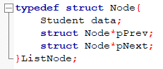
Program Architecture
Struct list node consists of student data and a pointer to the next node and a pointer to the precious node
List node
Listnode*pPrevious
Listnode*pNext
Student Data

Slide 9
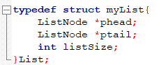
Program Architecture
Struct List is a struct that contains a pointer to the head of the List and a pointer contains a pointer to the tail of the list and an int list size
List
Listnode*pHead
Listnode*pTail
Int list size

Slide 10
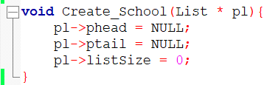
Program Architecture
The Function Create_School() takes a pointer to a struct List
And initialize the head and the tail to NULL (the list is empty)

Slide 11
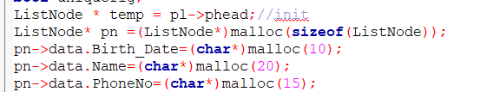
Program Architecture
The Function New_Student_ID takes a pointer to a Struct List and it cosists of several parts :
Memory allocation:
allocation of memory for the New Node and allocation for the new string data (date of birth and Name and phone number )

Slide 12
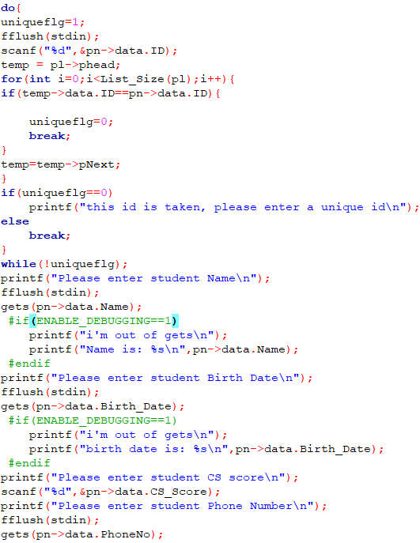
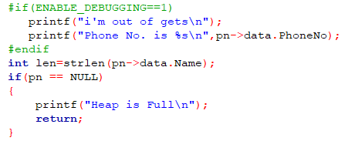
Data entry
This part is responsible for taking the data from the user and inserting it into the new Node and rejecting duplicate IDs by using a while loop which keep asking the user to enter a unique id until he enter a unique id

Slide 13
Program Architecture
- Insertion of the New Node in the List
If list is empty
Assign the head and the tail into the new node pointer
If id>all the ids in the list
Instert the new node at the tail
yes
yes
no
no
Else
The list is not empty
Else If id<all the ids in the list
Insert the new node at the head
Search for the suitable ids to put the new node between
yes
no
Else
Insert the new node between to other nodes in the middle

Slide 14
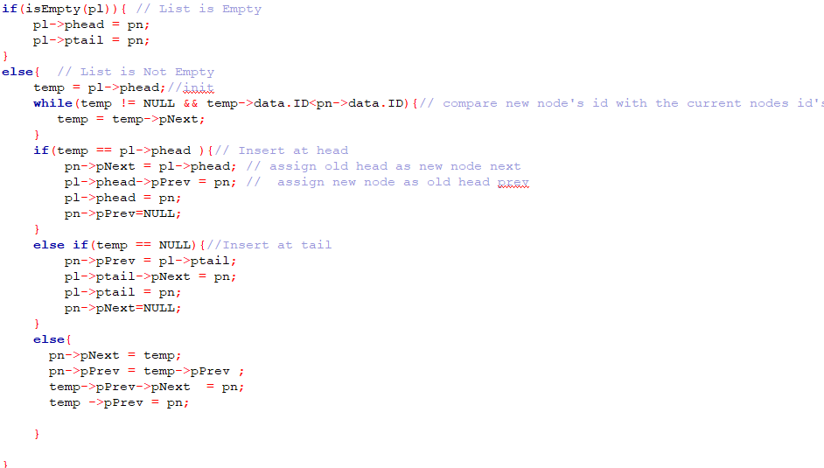
Program Architecture

Slide 15
Program Architecture
The Function New_Student_Name() is the same as New_Student_ID() the only difference is that it sort the students by their name using strcmp()

Slide 16
Program Architecture
The Function Delete_Student() takes the id of the student the userwants to delete then searchs for it and decide how to delete it
If id is not found
Print id not found
If the id is the 1st id
Set the previous pointer of the next node to NULL and free the allocated memory for the head
yes
yes
no
no
Else
Else If id is the last id
Set the Next pointer of the previous node to NULL and free the allocated memory for the Tail
yes
no
Else
Set the previous pointer of the next to the previous pointer of the deleted node and the next pointer of the previous to the next pointer of the deleted node

Slide 17
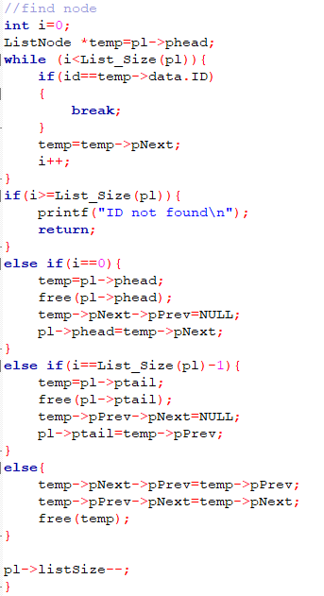

Slide 18
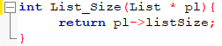
Program Architecture
The Function List_Size() this function returns the List size element which is increase each time we insert student
And decrease each time we delete a student

Slide 19
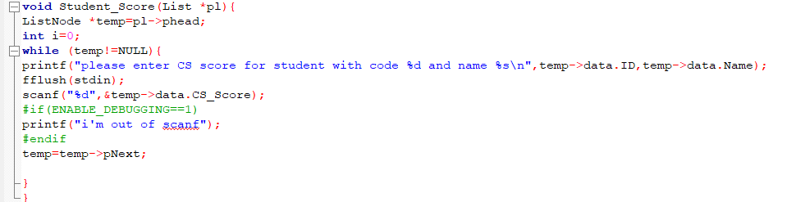
Program Architecture
The Function Student_Score() is simply a while loop that a loops across all the students and ask from the user to update their data

Slide 20
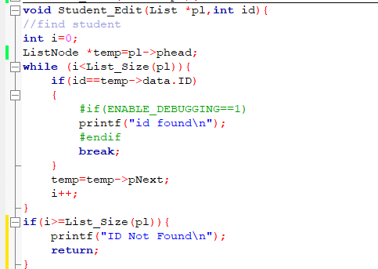
Program Architecture
The Function Student_Edit() searches for the student using his id then asks the user about the data he want to change

Slide 21
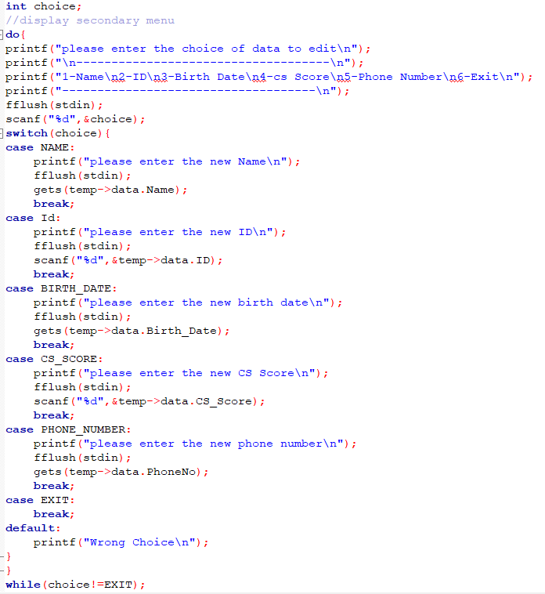

Slide 22
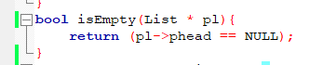
Program Architecture
The Function isEmpty() checks if the head is = to NULL and returns 1 if it’s empty and 0 if it’s not

Slide 23
Program Architecture
The Function Rank_Student() Put the students in a binary search tree and print them inorder according to their CS score the binary search tree is implemented in in a separate .c and .h file due to it’s extra complexity and it contains a struct called TreeNode which contain a pointer to the Next right branch and a pointer to the next left branch and a pointer to the student
Tree Node
TreeNode* leftptr
Student* data
TreeNode* Rightptr

Slide 24
Program Architecture
And this Tree.c file consists of 2 Functions Insert_Node() which insert a new node to the tree and inOrder() which prints the data in the tree in order (left root right) to be printed according to the CS score of the students

Slide 25
InsertNode() takes a pointer to a tree node pointer and a pointer to a struct student then it allocates memory for the new node, checks if the tree is empty and in this case it initialize the root of the tree as the student pointer added
And it have 0 branches so it’s left and right ptr =NULL
If the tree is not empty it compares the cs score of the new student to the student in the left branch if he has a higher score it recurse until it’s Null and add the student to the most left branch and if it’s not the higher score it goes to the right branch and recurse

Slide 26
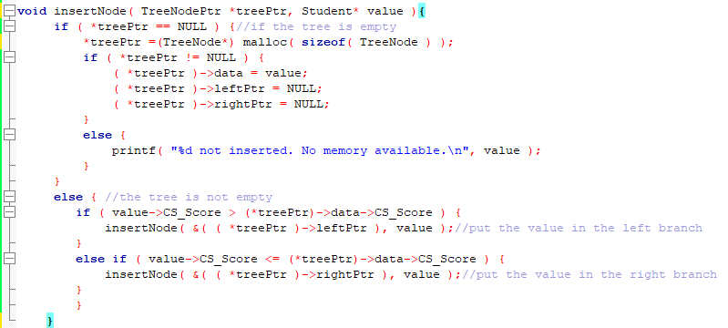

Slide 27
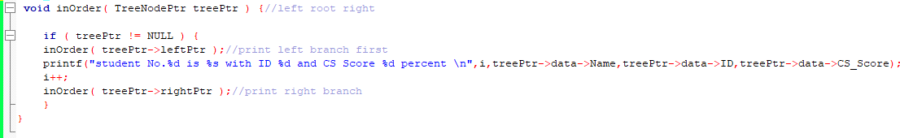
inOrder() recurse until it finds the deepest left node then print it then prints it’s root (the second deepest left node) then prints the right node then recurse to print the next left node and so on

Slide 28
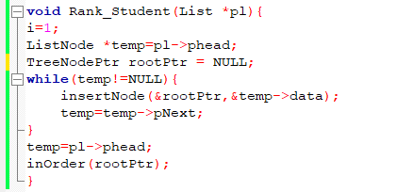
Back to the function Rank_Student() it simply consists of a while loop that loops across all the students and insert their addressees to the tree using InsertNode() and then print them all using inOrder() to print their names and IDs according to their CS scores

Slide 29
Program Architecture
The function main_menu() asks the user how he want to sort the data then asks the user which operation he want to do
Input sorting choice
New_Student_ID()
Input operation choice
no
If
Insert student
If
Sort by name
yes
New_Student_Name()
Else If
delete
Delete_Student()
……

